Slide 1

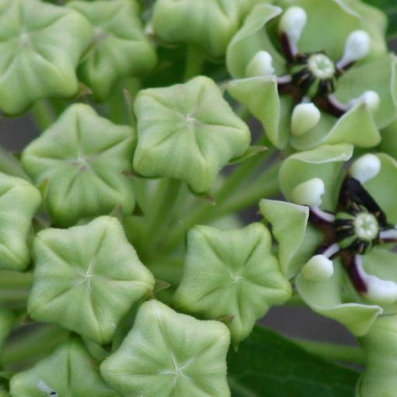





implementations and provocations from the asclepias project (2019)

Slide 2
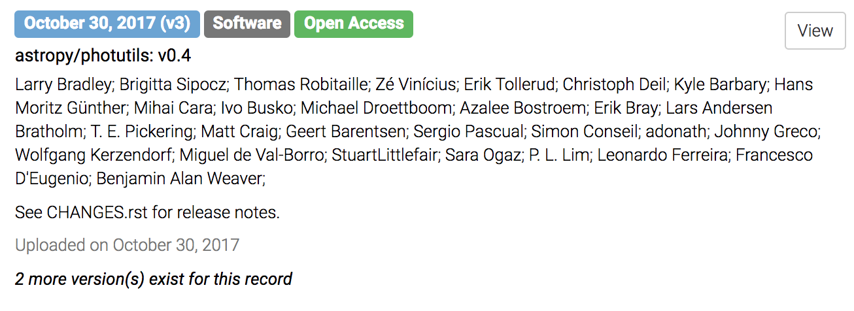
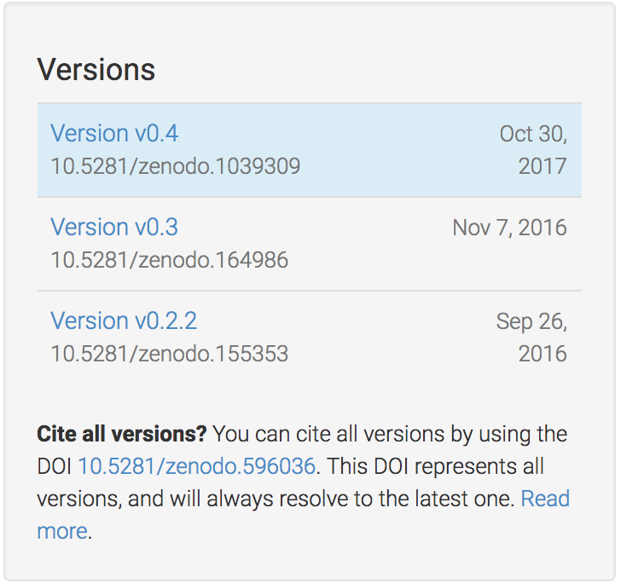
what is asclepias?
an infrastructure project funded by the Alfred P. Sloan Foundation to the AAS;
a collaboration of ADS (indexing), Zenodo (archiving), and AAS (publishing);
implementing the Force 11 software citation principles in these systems.

Slide 3
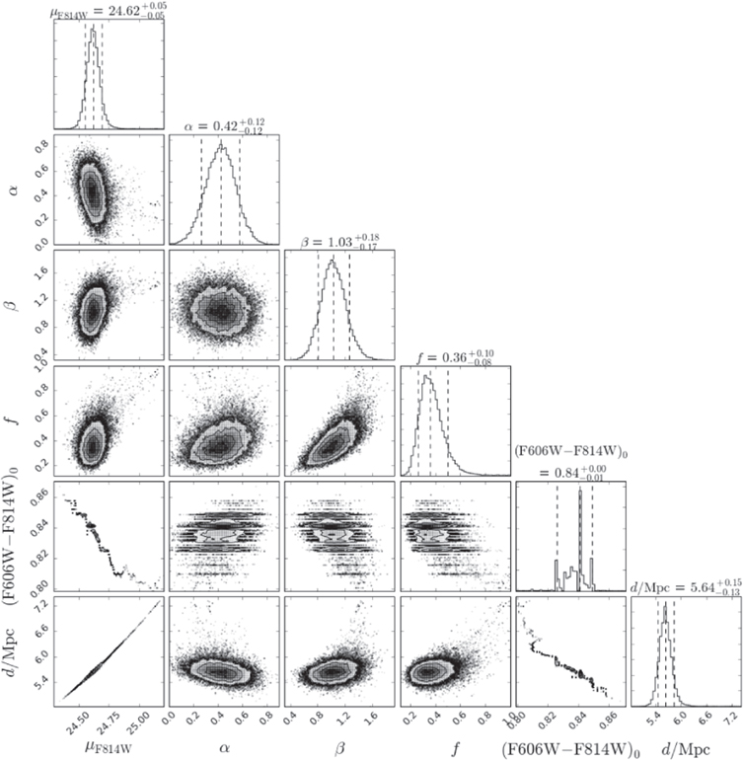
pieces and provocations
ADS indexing (Edwin. Henneken)
Zenodo Archiving (Lars Holm Nielsen)
asclepias broker software;
meet author research/bibliographic needs.
TNG: citation aggregation (by version or identifier)!

Slide 4
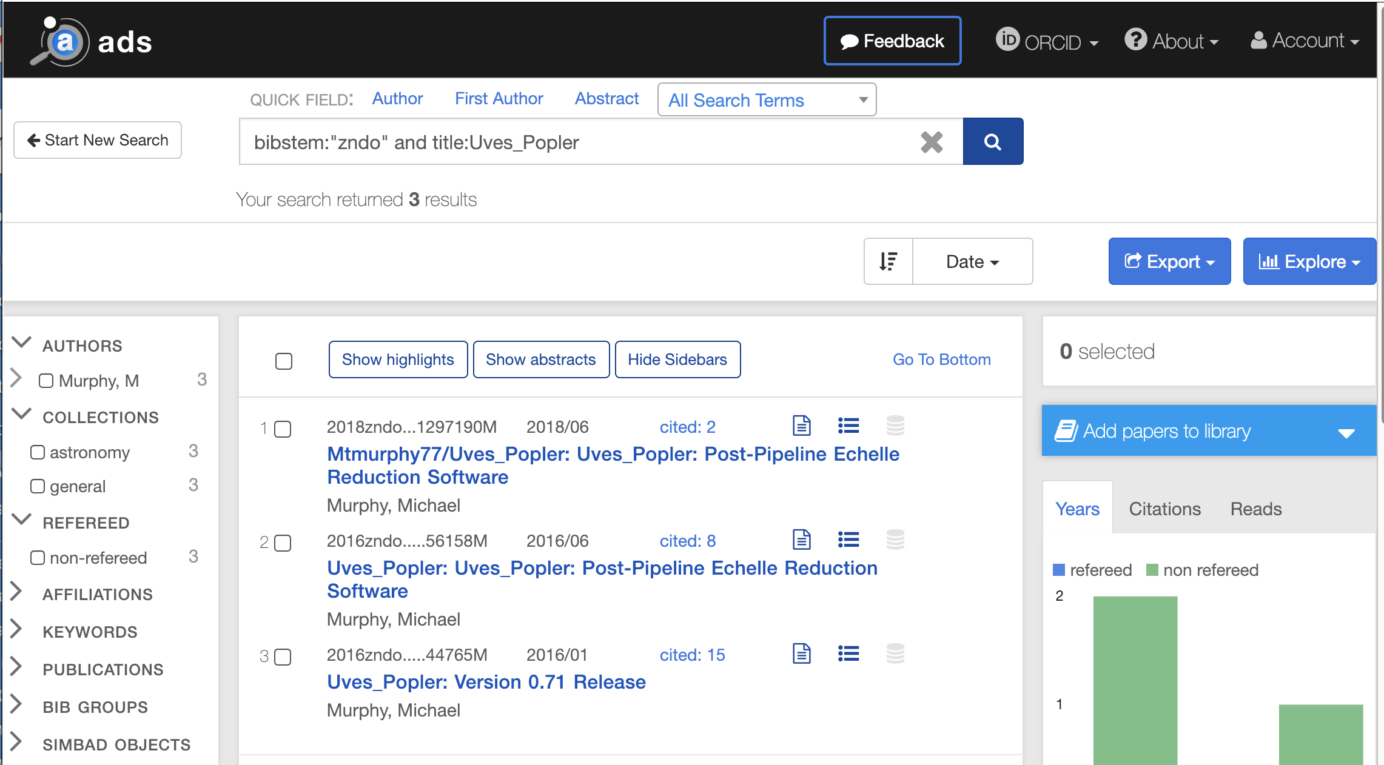
Status: ADS (more in next talk)
discover and index DOI based software citations;
emit software citation events for other services to ingest/use.

Slide 5
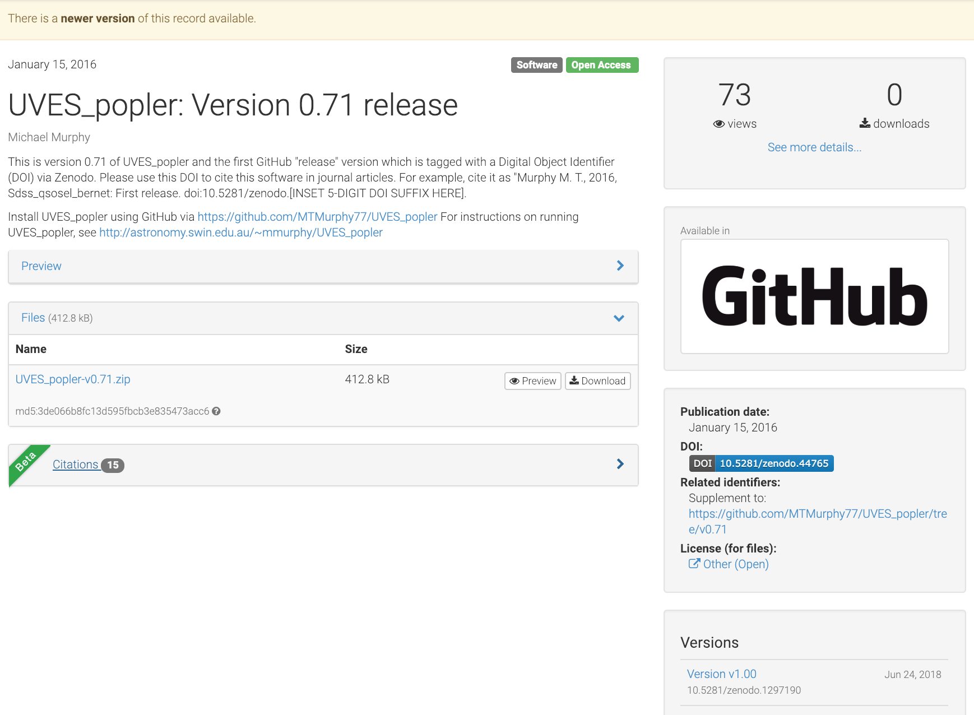
Status: Zenodo
Adding citation counts from multiple sources (CrossRef, ADS);
Pings a “broker” to listen for new citation events, rebuild metadata, and format new citations into UI.

Slide 6
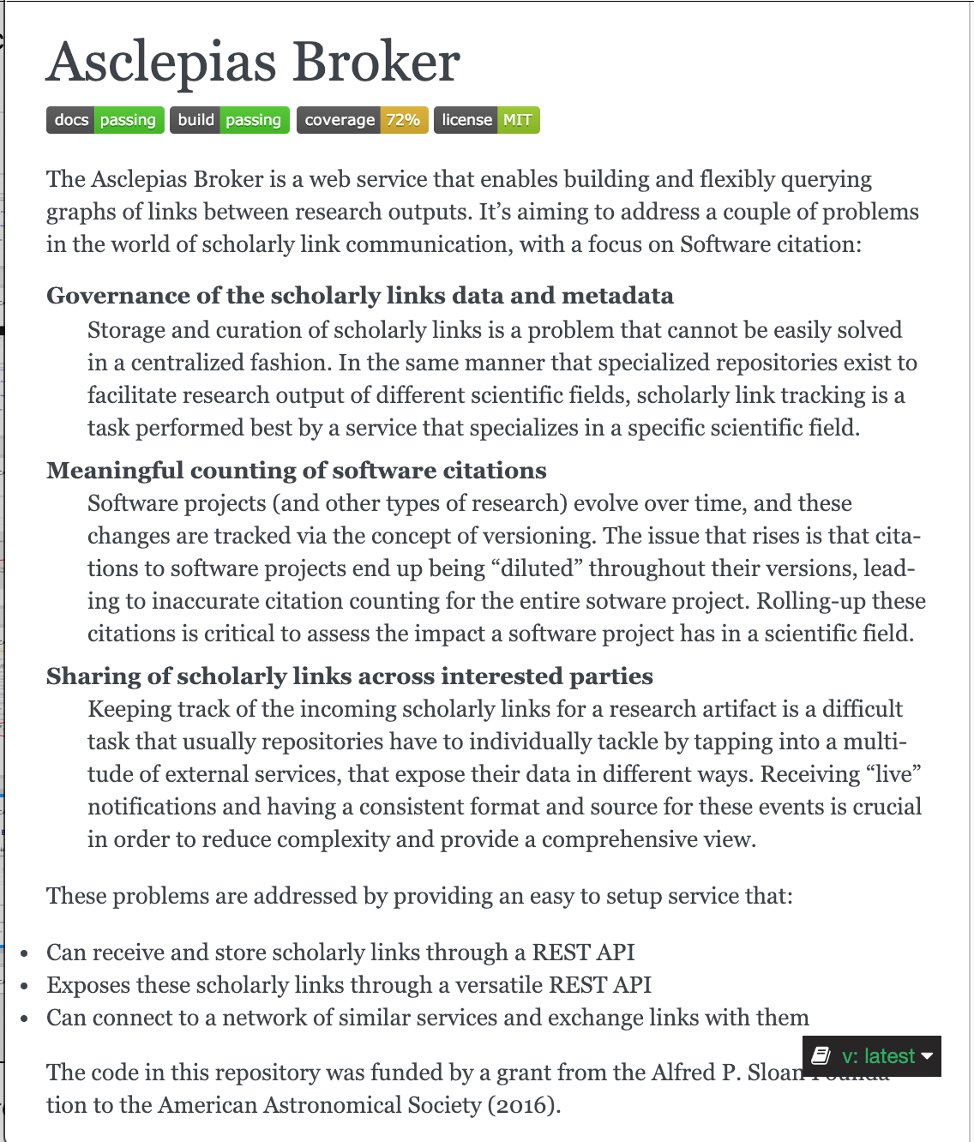
Status: Asclepias Broker
Can receive and store scholarly links through a REST API;
Exposes these scholarly links through a versatile REST API;
Can connect to a network of similar services and exchange links with them;
Builds/Rebuilds object metadata;
Provide platform for citation aggregation/curation.

Slide 7
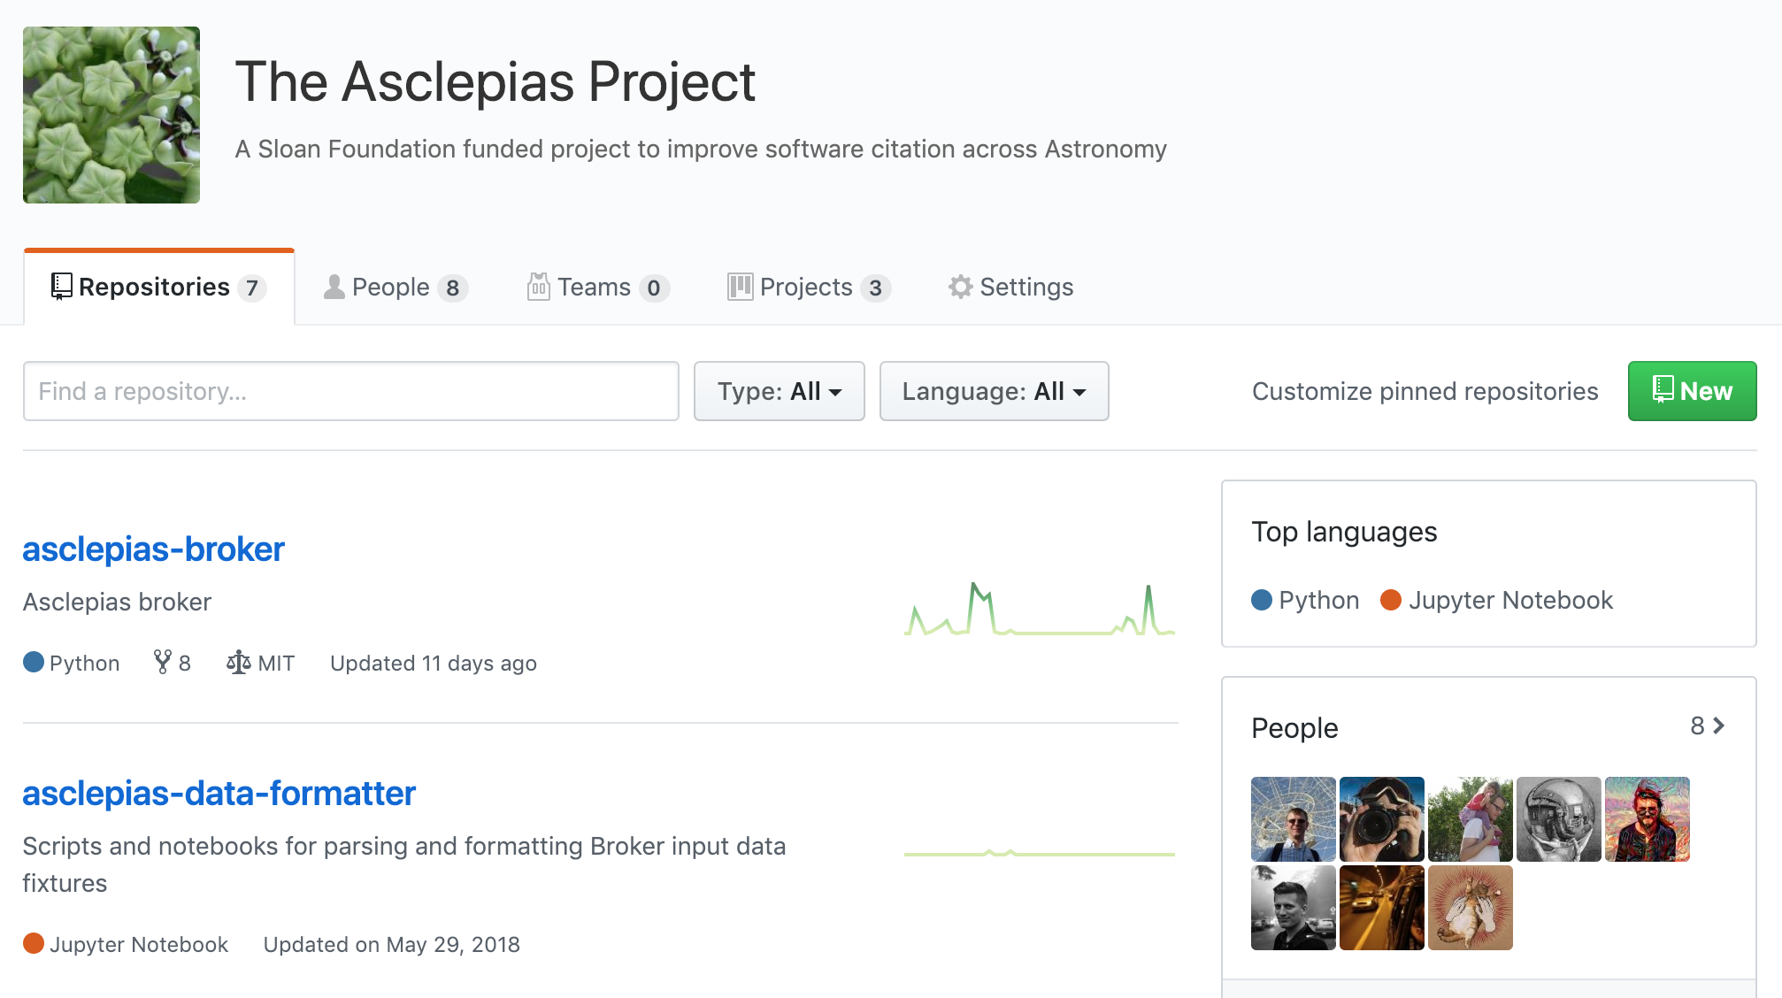
Asclepias Broker https://github.com/asclepias

Slide 8
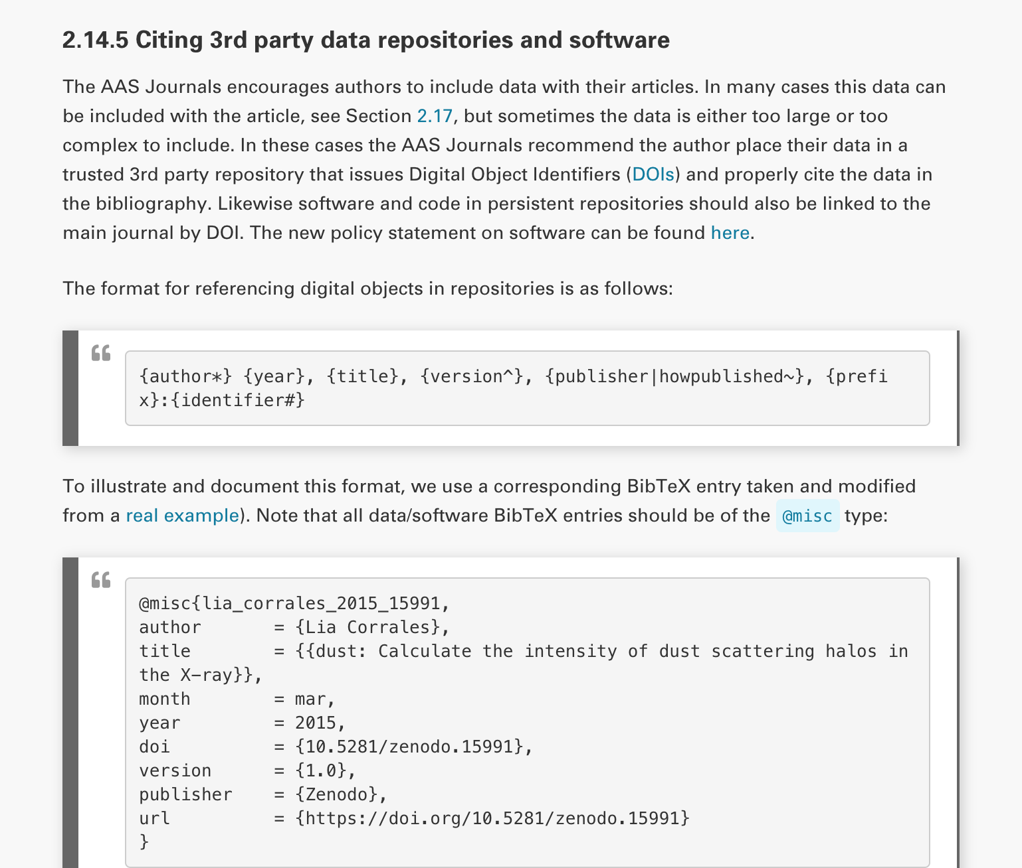
Status: AAS Publishing
AAS BibTeX style file has supported “version” and “publisher” fields for ~18 months (aasjournal.bst)
Use TeX tag \software{} to summarize and cite all the research code used for a paper;
Read the docs and use the ASCL to find a developer’s preferred citation method (paper, code, ASCL, aota)

Slide 9
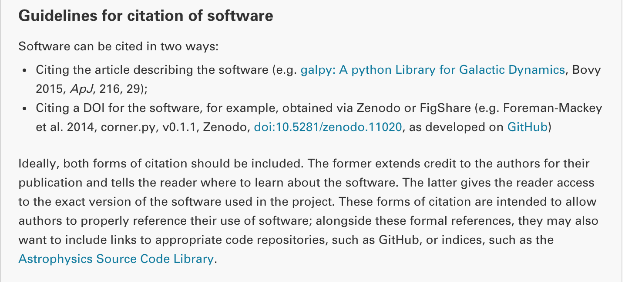
Observations...
Policy shmolicy;
People don’t follow directions;
Automated workflows are automated;
If you give a mouse a cookie...

Slide 10
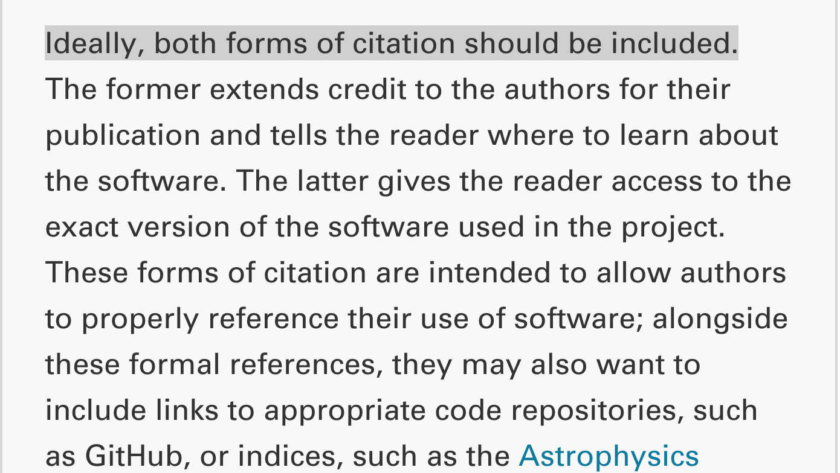
Observations...
Policy shmolicy;
People don’t follow directions;
Automated workflows are automated;
If you give a mouse a cookie...

Slide 11
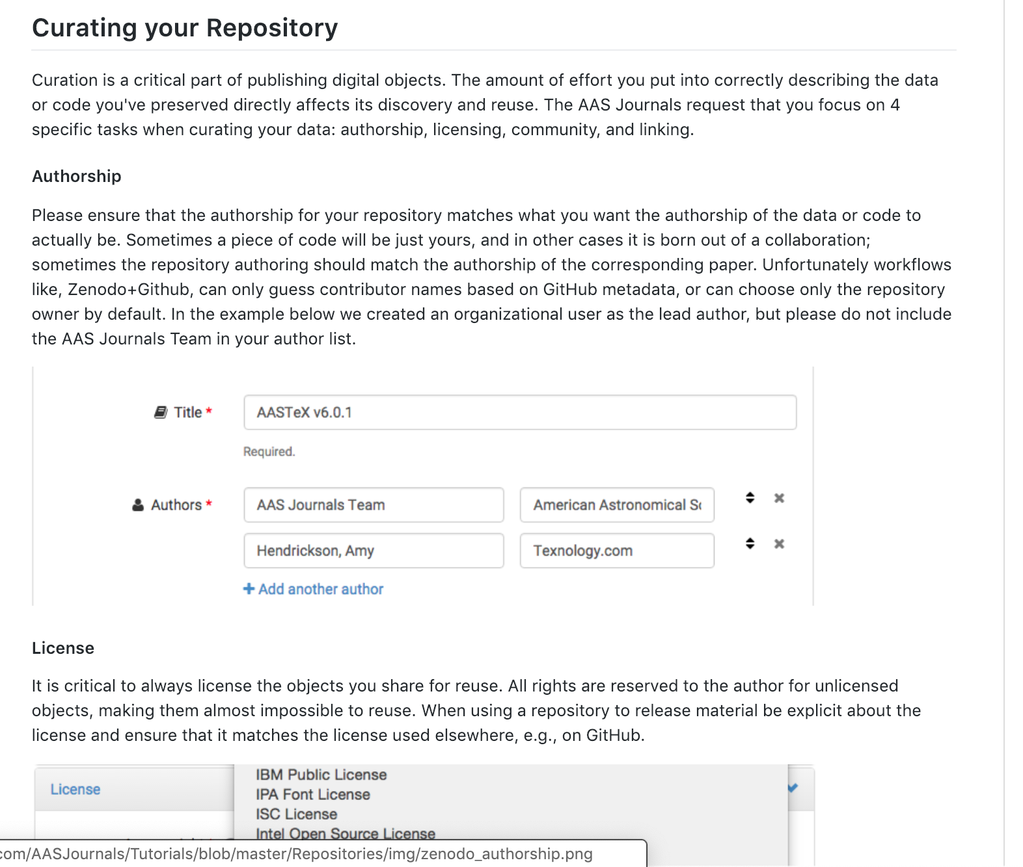
Observations...
Policy shmolicy;
People don’t follow directions;
Automated workflows are automated;
If you give a mouse a cookie...

Slide 12
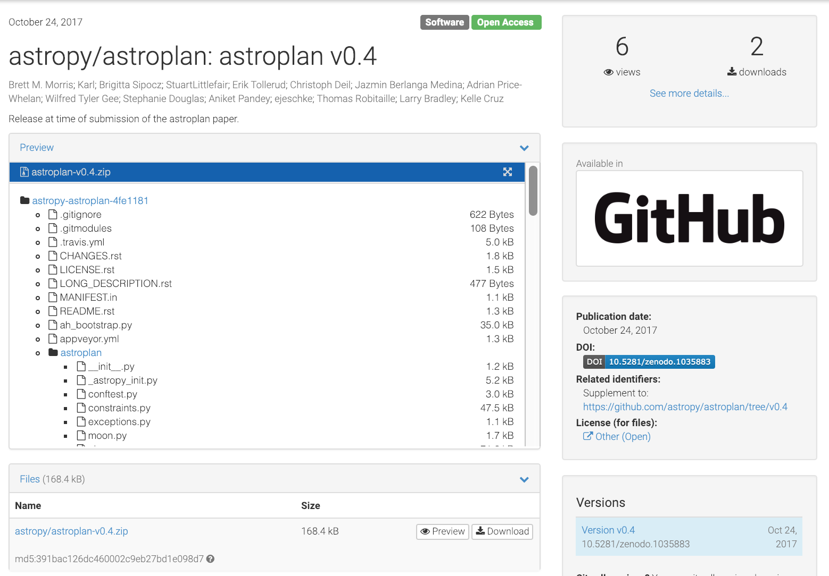
Observations...
Policy shmolicy;
People don’t follow directions;
Automated workflows are automated;
If you give a mouse a cookie...

Slide 13
Observations...
Policy shmolicy;
People don’t follow directions;
Automated workflows are automated;
If you give a mouse a cookie...

Slide 14

Observations...
Policy shmolicy;
People don’t follow directions;
Automated workflows are automated;
If you give a mouse a cookie...

Slide 15
Can you aggregate all the citations to my ApJ code paper and direct code citations and the ASCL citations, but remove the duplicates and don’t include citations to Version 1 of the code because I didn’t work on that version?¹
This is totally made up.

Slide 17
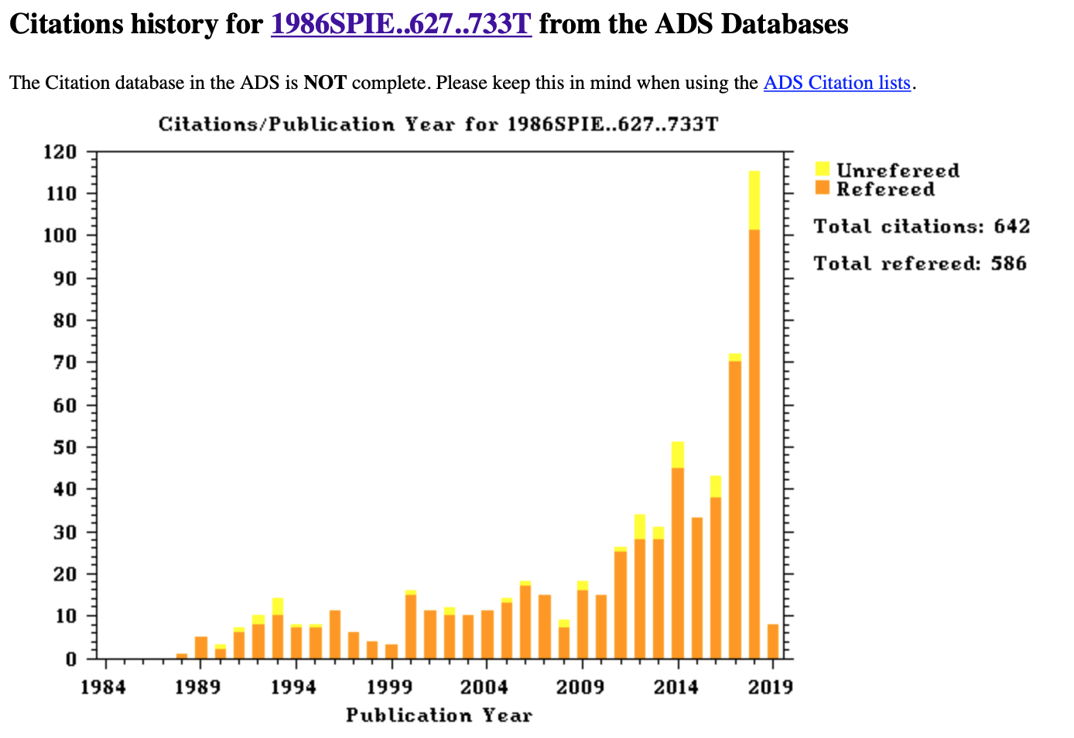
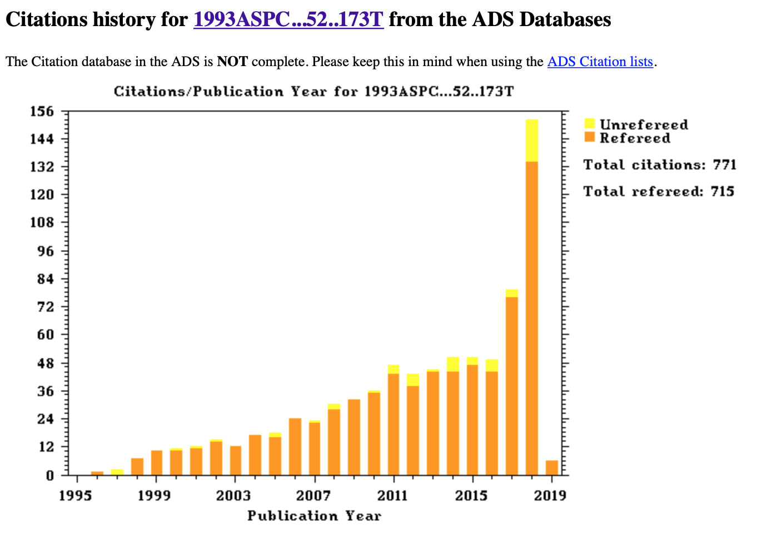
Can we fix uncited software mentions by suggesting code citations during data review at submission? We think these rapid increases in citations to these legacy codes are our fault.

Slide 19
Status: ADS (more in next talk)
3 versions each with individual citations (rates)

Slide 20
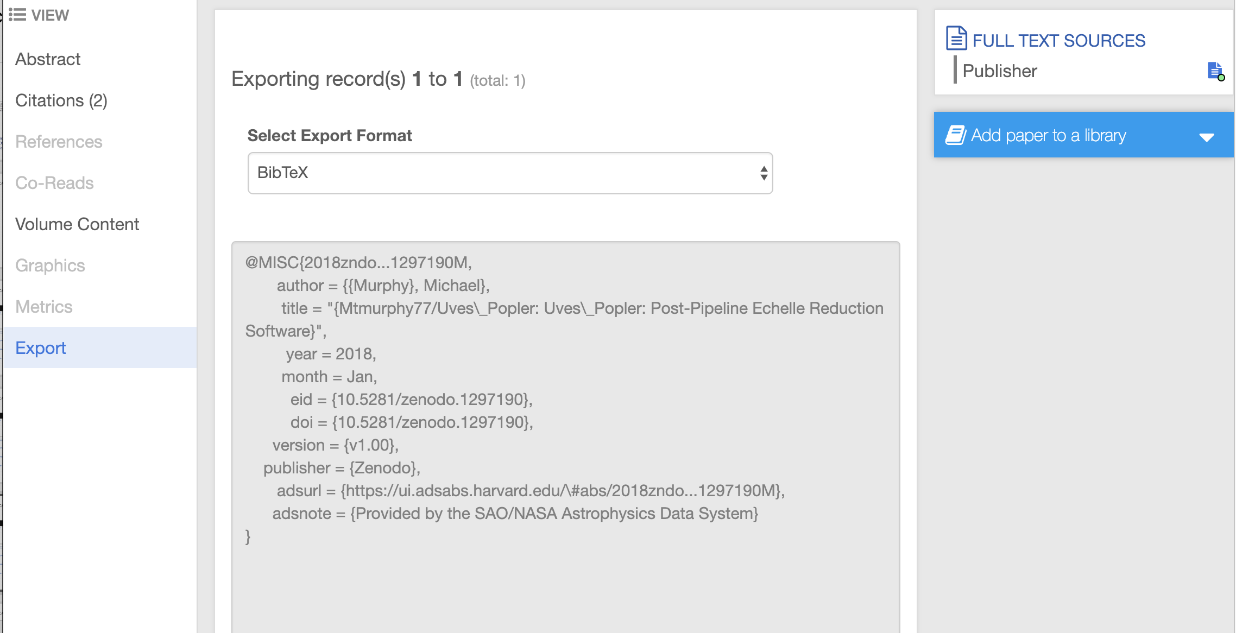
Status: ADS (more in next talk)
3 versions each with individual citations (rates)
BibTeX output with version;

Slide 22
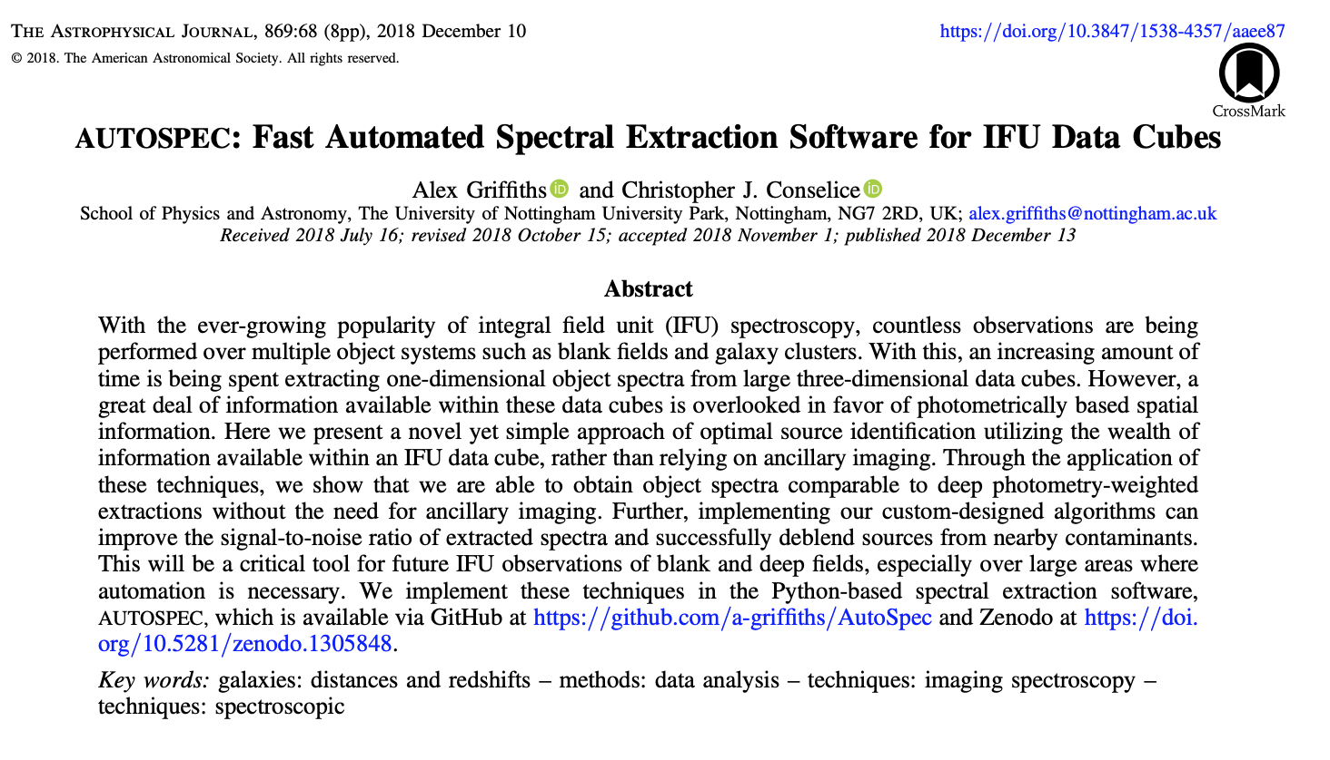
AAS Publishing & Developers:
Notes:
One of the data editors reads 90-100% of all submissions, looking for data or software to be preserved.

Slide 23
AAS Publishing & Developers:

Slide 24
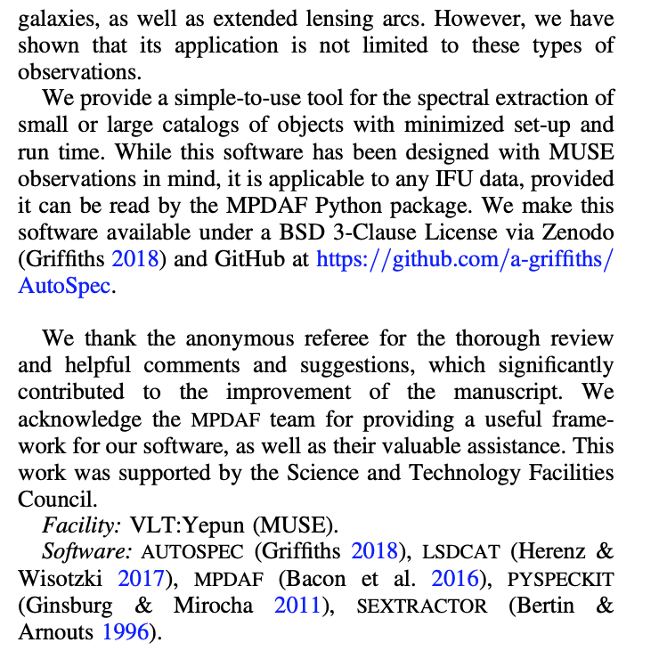
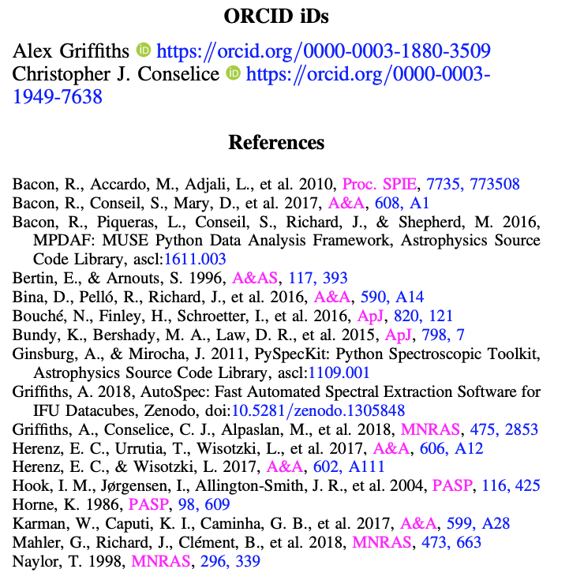
AAS Publishing & Developers:
Notes:
Ask authors to archive to Zenodo then cite in the text -- “code is actively developed at or available at and archived to Zenodo (Smith et al. 20XX).

Slide 25
AAS Publishing & Developers:

